Slide 1
The Secrets
Of Trading
Insider Edition
DATA SCIENCE INSTITUTION
DATA SCIENCE
Cristian Choco
01/08/2024

Slide 2
Table of
Contents
I
What is Insider Trading
3
II
Insider Trading Trends Over Time
4
III
Ownership Changes and Stock Prices
5
IV
Correlation Analysis
6
V
Company Specific Analysis
7

Slide 3
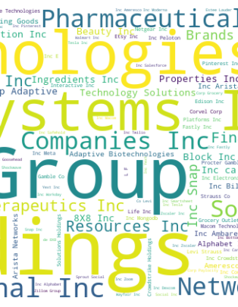
What is Insider Trading
Insider trading is the buying or selling of securities by individuals with non-public information about a company. This includes executives and employees who have privileged access to material information.
The key factors involve trading on undisclosed information, breaching fiduciary duty, and gaining an unfair advantage.
Widely recognized as illegal, insider trading is prohibited to maintain fair and transparent financial markets.
Violations incur serious consequences, such as fines, imprisonment, and profit disgorgement. Regulators and exchanges rigorously enforce rules to ensure market integrity and equitable treatment for all investors

Slide 4
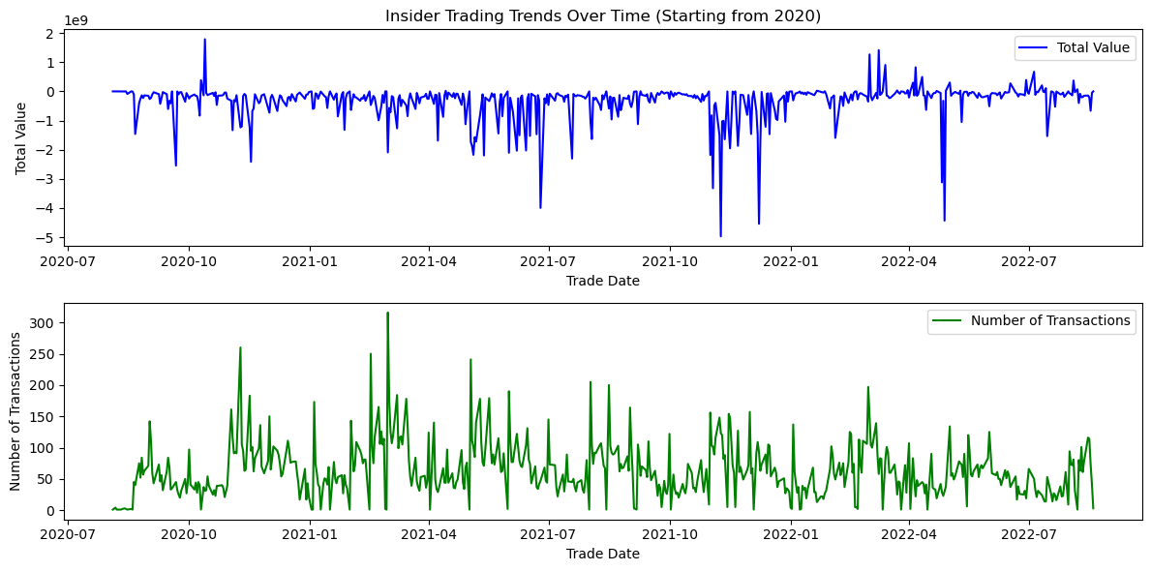
Insider Trading Trends Over Time
Insider trading over time
The following graphs explain insider trading trends over the periods of months.
The correlation between the total value and the number of transactions conclude that as the value decreases the number of transactions increase as well.

Slide 5
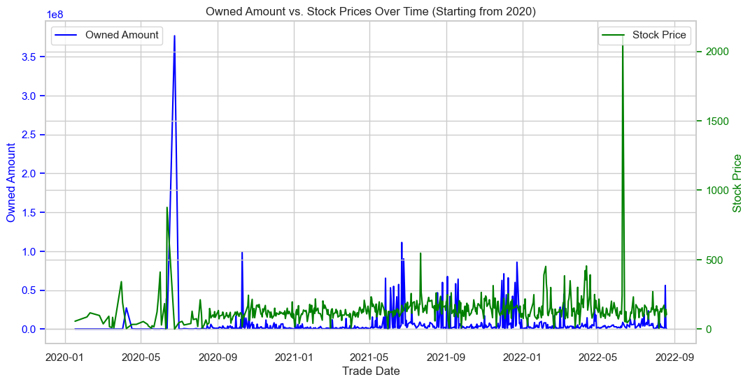
Ownership Changes and Stock Prices
Relationship between Ownership Changes and Stock Price Movements
Key Insights
Insider stock ownership tends to increase as the stock price goes up.
Higher volatility, higher ownership: Insider stock ownership increases during periods of high stock volatility.
Implication for investors: Understanding these patterns can inform investment strategies.

Slide 6
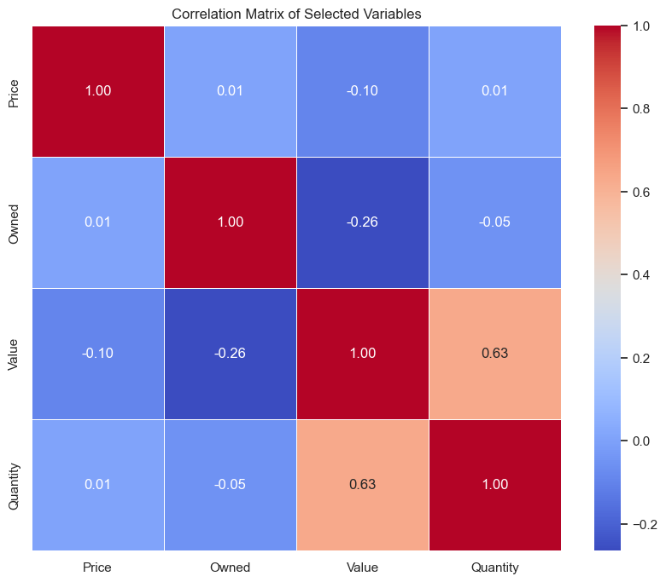
Correlational Analysis
The correlation analysis of the 4 variables between the price, ownership, value, and quantity
The quantity and the value has the highest order of correlation which means that the quantity sold/purchased is positively correlated with the value of the stock price.
Meanwhile the other metrics show a weak negative correlation between the price and owned

Slide 7
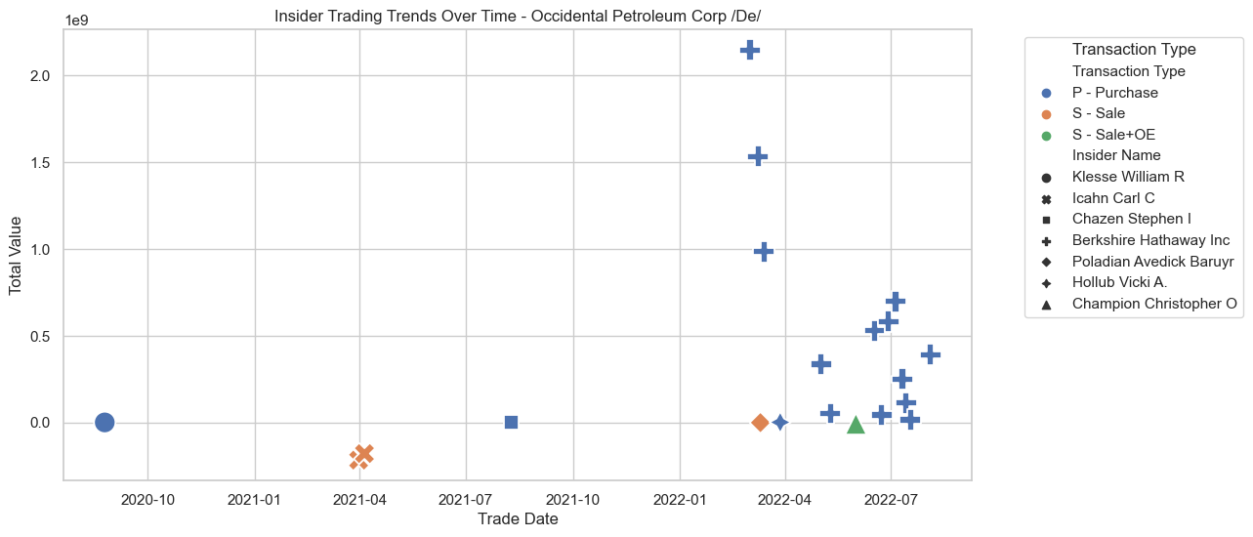
Company Specific Analysis: Occidental petroleum Corp /De/
The trends indicate the value at which each insider sold/ purchased
Notes:
OE- is an option exercise, which concludes with the immediate sale of exercised options for a risk-free profit

Slide 8
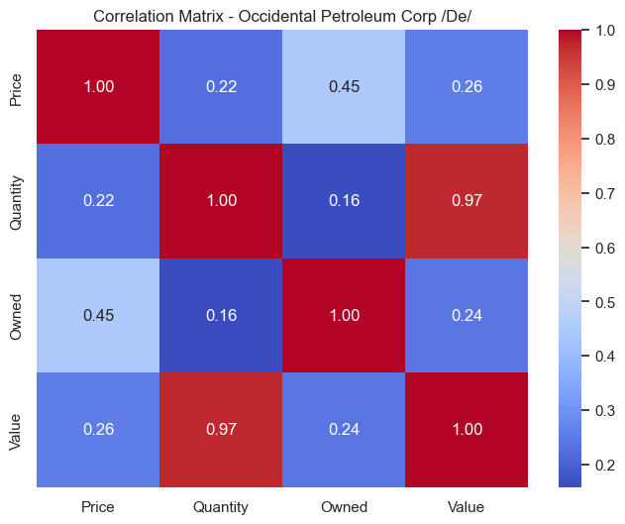
Further analysis
Just looking at one company can show that the correlation between each of the following matrices has a bigger influence than when comparing all inside trading all together.
A big difference is a stronger positive correlation between quantity and value,
Also the price and owned became a negatively moderate correlation .

Slide 9
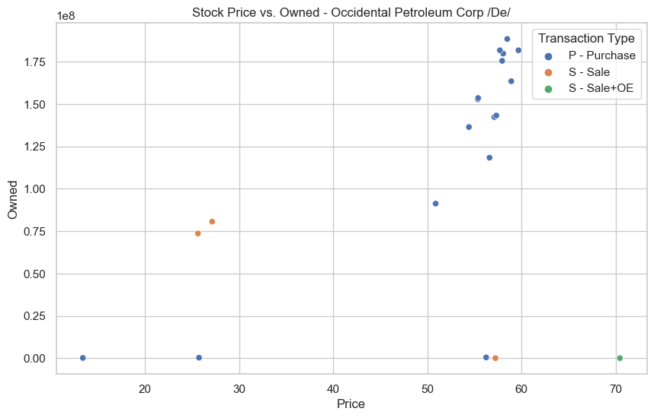
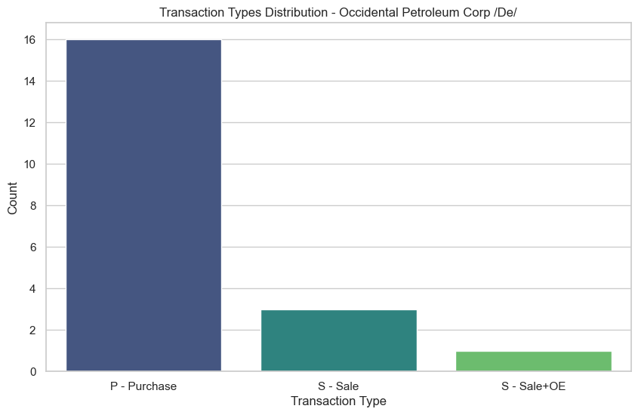
Transactions
Transaction types
Duration
Purchase, Sales
Option exercise
2020 May to September 2022
There were more purchases within the transaction types compared to the sales and option exercise,
The high count for purchase does show the high total value for the amount of stock within the company: TIcker;OXY
The bar graph also shows the predominant activity when it comes to how OXY began to incrementally increase in total value

Slide 10
Summary
1
2
3
Insider trading is non public information that is used to have an advantage in the stock market
The ownership of stock compared to the prices does seem to have a slight correlation when the prices tend to go up
The correlation between the quantity and value is very significant, but is very dependent on each company

Slide 11

Thank you

